Slide 1
Unit 10
Socio Technical System
Prepared by: Sachita Maharjan

Slide 2
1. Complex systems
A system is a purposeful collection of inter-related components working together to achieve some common objective
A system may include software, mechanical, electrical and electronic hardware and be operated by people
System components are dependent on other system components
The properties and behavior of system components are inter-mingled; this leads to complexity

Slide 3
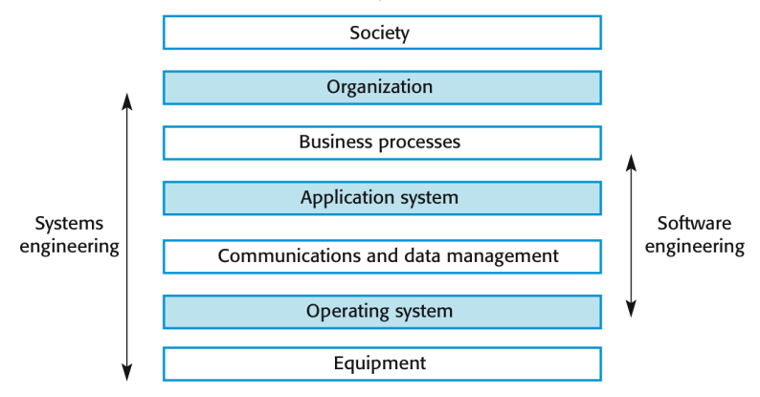
1.1 The sociotechnical systems stack

Slide 4
Systems
Software engineering is not an isolated activity but is part of a broader systems engineering process
Software systems are therefore not isolated systems but are essential components of broader systems that have a human, social or organizational purpose
Example
▪ Wilderness weather system is part of broader weather recording and forecasting systems
▪ These include hardware and software, forecasting processes, system users, the organizations that depend on weather forecasts, etc.

Slide 5
1.1 Layers in the STS stack
Equipment: Hardware devices, some of which may be computers. Most devices will include an embedded system of some kind.
Operating system: Provides a set of common facilities for higher levels in the system
Communications and data management: Middleware that provides access to remote systems and databases
Application system: Specific functionality to meet some organization requirements
Business processes: A set of processes involving people and computer systems that support the activities of the business
Organizations: Higher level strategic business activities that affect the operation of the system
Society: Laws, regulation and culture that affect the operation of the system

Slide 6
1.2 Socio-technical system characteristics
Emergent properties: Properties of the system of a whole that depend on the system components and their relationships
Types of emergent property
Functional emergent properties: These appear when all the parts of a system work together to achieve some objective. For example, a bicycle has the functional property of being a transportation device once it has been assembled from its components.
Non-functional emergent properties: Examples are reliability, performance, safety, and security. These relate to the behavior of the system in its operational environment. They are often critical for computer-based systems as failure to achieve some minimal defined level in these properties may make the system unusable
Non-deterministic: They do not always produce the same output when presented with the same input because the system’s behavior is partially dependent on human operators

Slide 7
1.3 Failure Propagation
Failure propagation refers to the process by which a failure in one part of a system can lead to subsequent failures or problems in other parts of the system.
When a system is designed, engineers typically try to anticipate potential points of failure and build in redundancies or fail-safe mechanisms to prevent or mitigate these failures.
However, despite these efforts, failures can still occur and can sometimes lead to a cascade of problems that can be difficult to contain or resolve.

Slide 8
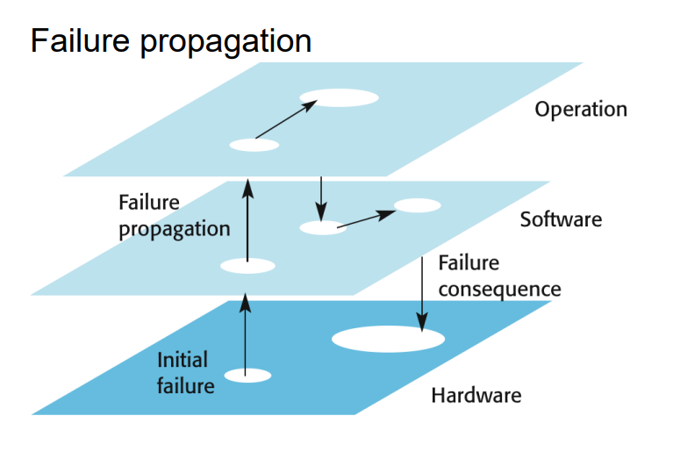
Failure Propagation

Slide 9
Example:
Another example of failure propagation can be found in software systems. When a bug or security vulnerability is discovered in a software program, attackers can exploit this vulnerability to gain unauthorized access to the system or cause it to malfunction.
In some cases, the failure can spread to other parts of the system or even to other systems that are connected to it, leading to a chain reaction of problems that can be difficult to control.
To prevent failure propagation, engineers and system designers need to consider the potential points of failure in a system and build in redundancies, fail-safe mechanisms, and other safeguards to prevent problems from cascading out of control.
They also need to have a plan in place to quickly identify and respond to failures when they occur, and to limit the potential impact of those failures on other parts of the system.

Slide 10
2. Systems engineering
Procuring, specifying, designing, implementing, validating, deploying and maintaining socio-technical systems.
Concerned with the services provided by the system, constraints on its construction and operation and the ways in which it is used to fulfill its purpose or purposes

Slide 11
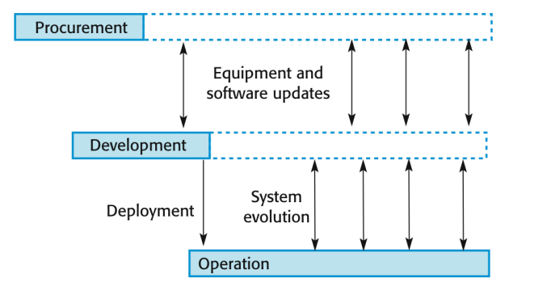
2.1 Stages of systems engineering

Slide 12
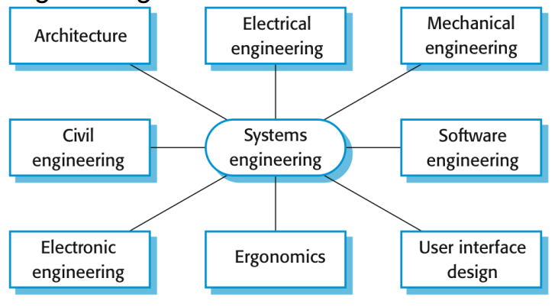
2.2 Professional disciplines involved in systems engineering

Slide 13
Question
What is Complex System? Explain Socio technical system stack with proper examples
What is System Engineering? Explain stages of system engineering.

Slide 14
3. System procurement
Acquiring a system (or systems) to meet some identified organizational need.
Before procurement, decisions are made on:
▪Scope of the system
▪System budgets and timescales
▪High-level system requirements
Based on this information, decisions are made on whether to procure a system, the type of system and the potential system suppliers

Slide 15
3.1 Decision drivers for procurement
The state of other organizational systems
The need to comply(follow) with external regulations
External competition
Business re-organization
Available budge

Slide 16
3.2 Procurement and development
Some system specification and architectural design is usually necessary before procurement
▪You need a specification to let a contract for system development
▪The specification may allow you to buy a commercial off-the-shelf (COTS) system. Almost always cheaper than developing a system from scratch
Large complex systems usually consist of a mix of off the shelf and specially designed components. The procurement processes for these different types of component are usually different

Slide 17
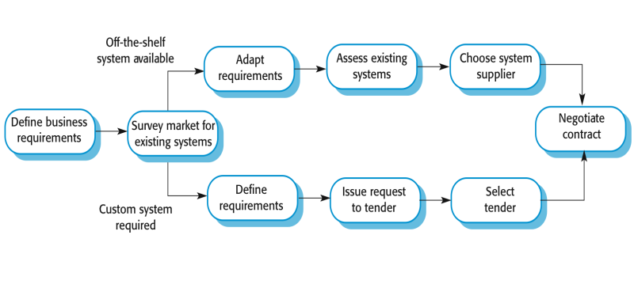
3.3 System procurement processes

Slide 18
4. System development
System development in system engineering refers to the process of designing, implementing, testing, and maintaining complex systems to meet specific requirements.
It involves a range of activities, including requirements analysis, system design, software development, testing, and deployment.
Throughout the system development process, system engineers use various tools and techniques to manage complexity and ensure that the system is delivered on time and within budget. These may include project management tools, software development frameworks, and testing tools.

Slide 19
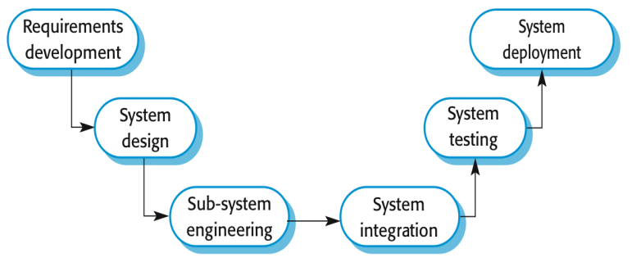
4.1 System Development

Slide 20
5. System Operation
System operation in system engineering refers to the ongoing maintenance, support, and management of a system after it has been deployed.
This phase of the system life cycle is critical to ensuring that the system continues to function properly, meets user needs, and remains secure and reliable.
During the system operation phase, system engineers may perform a range of activities, including:

Slide 21
5.1 System Operation
Monitoring the system: This involves tracking the system's performance, capacity, and availability to ensure that it is meeting the needs of its users. Engineers may use monitoring tools to track system metrics and identify potential issues before they become critical.
Maintaining the system: This involves performing routine maintenance tasks, such as installing updates, patches, and bug fixes, and addressing hardware or software issues as they arise.
Providing support to users: This involves responding to user requests for help, troubleshooting issues, and providing guidance on how to use the system effectively.
Managing system security: This involves implementing and maintaining security controls, such as firewalls, intrusion detection systems, and access controls, to protect the system from unauthorized access, data breaches, and other security threats.
Planning for system upgrades and migrations: This involves planning for and executing system upgrades, migrations, or retirements as the system's needs change over time.

Slide 22
5.2 Software Configuration Management
In Software Engineering, Software Configuration Management(SCM) is a process to systematically manage, organize, and control the changes in the documents, codes, and other entities during the Software Development Life Cycle. The primary goal is to increase productivity with minimal mistakes.
SCM is part of cross-disciplinary field of configuration management and it can accurately determine who made which revision.
Configuration management (CM) is a systems engineering process for establishing and maintaining consistency of a product's performance, functional, and physical attributes with its requirements, design, and operational information throughout its life.
For more info. : https://www.guru99.com/software-configuration-management-tutorial.html

Slide 23
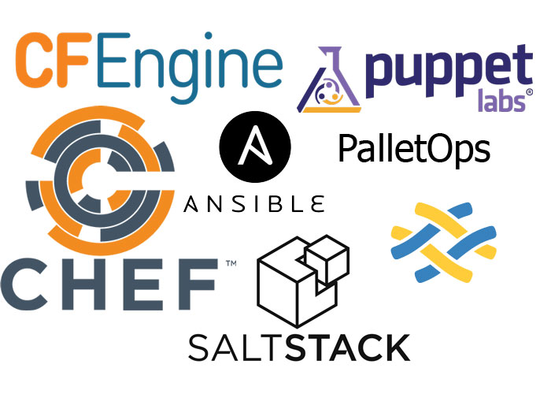
5.2 Software Configuration Management Tools
Most configuration management involves a high degree of automation to achieve these goals. This is why teams use different tools like Puppet, Ansible, Terraform and other configuration management tools.
By using automation, it's easier to build in checks and redundancies, improving the potential for omissions due to human error and the accuracy for keeping assets in the desired state

Slide 24
5.3 ISO 9001 history and revisions: ISO 9001:2000, 2008, and 2015
ISO 9001 was first published in 1987 by the International Organization for Standardization (ISO), a specialized international agency for standardization composed of the national standards bodies of more than 160 countries. The standards underwent revisions in 2000 and 2008. The most recent versions of the standard, ISO 9000:2015 and ISO 9001:2015, were published in September 2015.
ASQ administers the U.S. Technical Advisory Groups and subcommittees that are responsible for developing the ISO 9001 family of standards. In its standards development work, ASQ is accredited by ANSI.

Slide 25
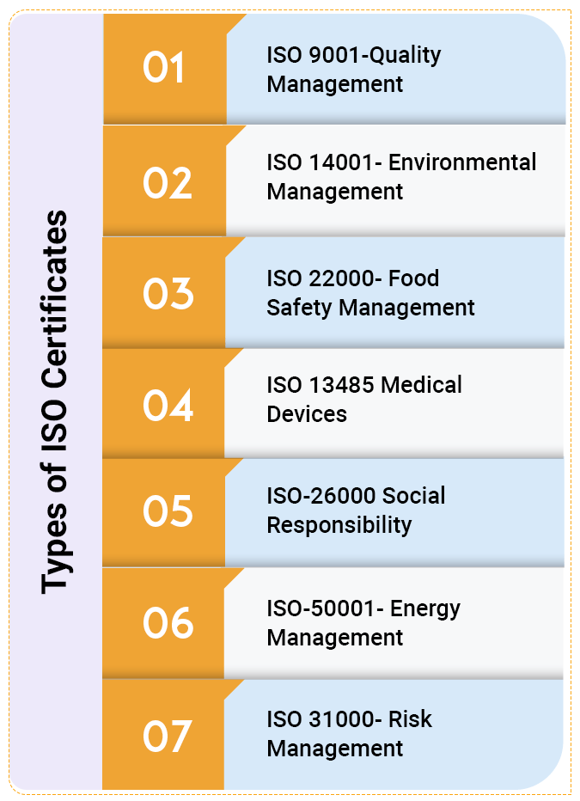
5.3 Types of ISO Certificate:

Slide 26
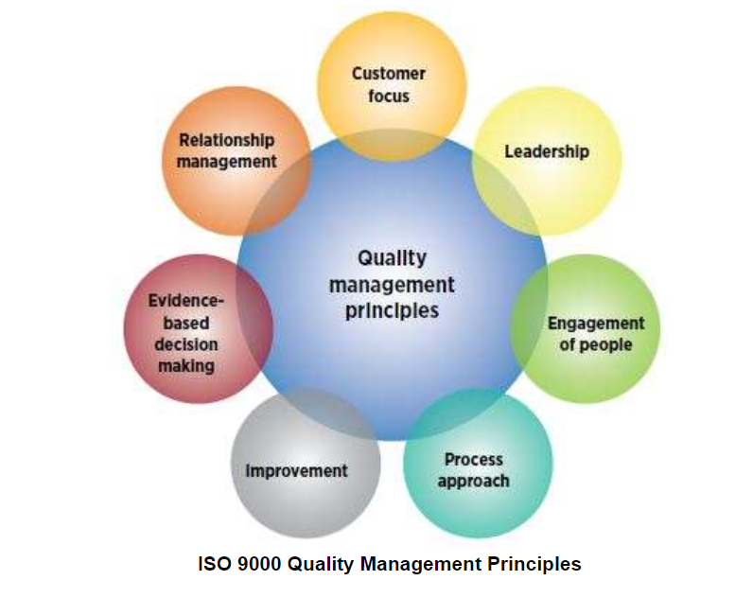
5.4 ISO 9001:2015 principles of Quality Management
The ISO 9000:2015 and ISO 9001:2015 standards are based on seven quality management principles that senior management can apply to promote organizational improvement.

Slide 27
Question:
What is System Engineering? What are the stages of System Engineering? Explain each stages with examples.

